Slide 1
Deviations from the resonance theory of tempo induction
CIM04 - Conference on Interdisciplinary Musicology - Proceedings
Martin F. McKinney
Dirk Moelants
Presenter: Mao-Yuan Kao
Date: Oct. 27, 2006

Slide 2
Introduction
The models were applied to predict distributions of perceived
tempo for large collections of music. However, in many pieces
the tempo is ambiguous, allowing several metric levels to serve
as the beat.
We evaluate the appropriateness of a resonance model for tempo
induction to predict the tempo perception of a group of listeners
to single excerpts of music and we identify rhythmic and acoustic
properties for excerpts that deviate from a resonator-model
prediction of their perceived tempo.

Slide 3
Introduction (cont.)
It is typical for such systems to provide a single tempo value or
multiple candidate values, often at different metrical levels.
However, in view of the inherent ambiguity, a single tempo value
does not sufficiently describe the group response,
e.g., perceived beat, of a single excerpt of music.
A better method should accurately describe the relative ambiguity
of tempo across group responses. Such a method would allow
meaningful quantitative evaluation of tempo extractor systems.

Slide 4
Method
Two experiments were performed to assess how closely the
distribution of perceived pulse across listeners follows the
resonance theory of tempo induction for individual musical
excerpts.

Slide 5
Experiment 1
33 subjects were asked to tap to the “beat” of 24 10-sec excerpts
of music.
Subjects were staff members and students at Philips Research
Laboratories and they had an average of 7 years of musical
education.
Each musical excerpt was played once to give the subject a
preview and then played a second time while the subject tapped
out the beat.

Slide 6
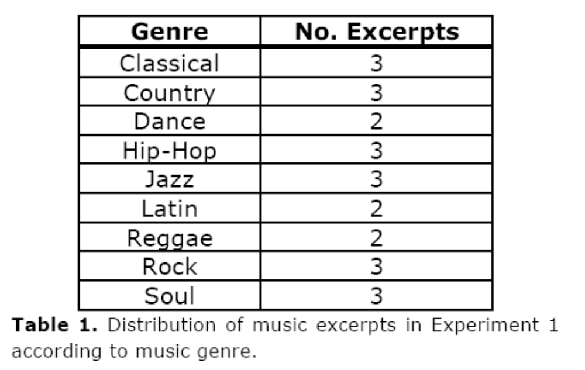
Experiment 1 (cont.)
The excerpts were taken primarily from Western popular music; a
breakdown of music genres and the corresponding number of
excerpts from each are given in Table 1.

Slide 7
Experiment 2
24 subjects tapped to the beat of 60 30-second excerpts of music.
Subjects were staff members and students from the musicology
department at Ghent University. They had an average of 12 years
of musical education.

Slide 8
Experiment 2 (cont.)
60 pieces were selected in view of maximizing the stylistic
differences and the variety of the musical content. An equal
number of pieces (6) were taken from 10 stylistic categories:
1. pop music, 2. rock music, 3. heavy metal & punk,
4. afro-American pop music (R&B, soul, reggae, rap, hip-hop),
5. dance (techno, house, drum & bass), 6. classical music,
7.jazz, 8. folk, chanson & cabaret, 9. ethnic & world music,
10. soundtracks, light classical music.

Slide 9
Analyses
Perceived tempo in beats per minute (BPM) was calculated from
the tap times using linear regression after estimating the beat
period from the median tap interval.
For Experiment 1, two groups of subjects were defined based on
their musical background:
those with more than 10 years of musical training were called
musicians;
those with less than 10 years of musical training were called
non-musicians.

Slide 10
Analyses (cont.)
In Experiment 2, all subjects had enough musical education to
combine them into one group (musicians).
For each excerpt, a histogram of perceived tempo values was
generated and used to estimate the two most dominant perceived
tempi, H(T1) and H(T2).
The two highest peaks in the histogram were taken to represent
the dominant perceived tempos for that excerpt.

Slide 11
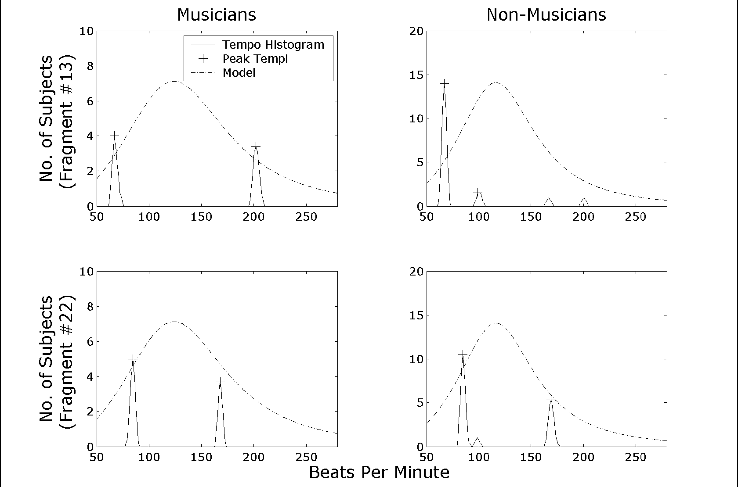
Analyses (cont.)

Slide 12
Analyses (cont.)
This relationship reflects the fact that different listeners were
tapping at different metrical levels to the same musical excerpt.
For Excerpt #13, the non-musicians predominantly tapped at 67
BPM while the musicians were split across 67 and 202 BPM.
For Excerpt #22 (bottom panels), both musicians and non-
musicians were split across 84 and 168 BPM.

Slide 13
Analyses (cont.)
A consequence of the postulated resonance in tempo perception is
that the relation between the predominant perceived tempi and
the resonant tempo of the model could be used to predict the
ambiguity of tempo across listeners.
If a musical excerpt contains a metrical level whose tempo lies
near the resonant tempo, the perceived tempo across listeners is
likely to be dominated by the tempo of that metrical level
and be relatively unambiguous.
If, on the other hand, the tempos of adjacent metrical levels
straddle the resonant tempo, the perception across listeners would
tend to be split evenly across those tempos and be more
ambiguous.

Slide 14
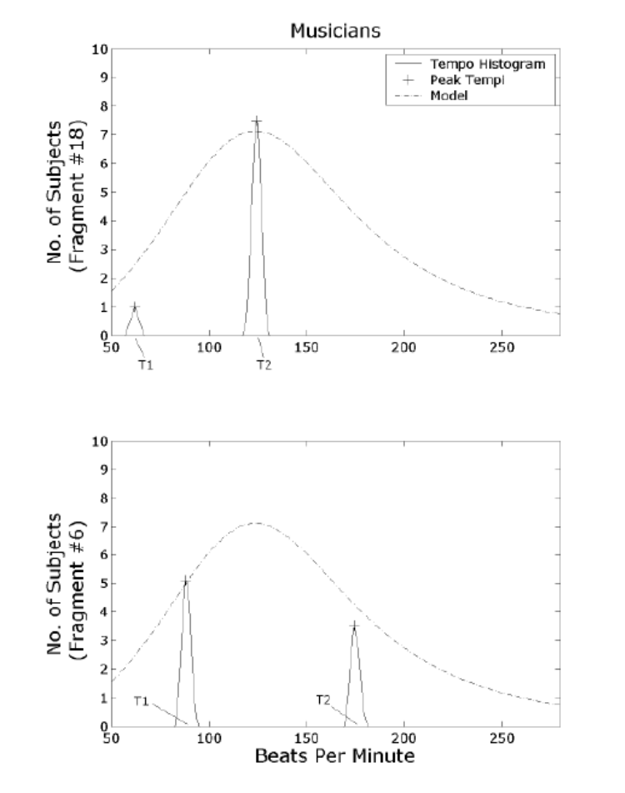
Analyses (cont.)
Histograms of tapped tempos from musicians for two musical excerpts (same format as Fig. 1). The lowest and highest dominant tempos are denoated T1 and T2, respectively.
For Excerpt #18 (top panel), the predominant perceived tempo (at T2) falls near the model resonant tempo and is relatively unambiguous
across subjects.
For Excerpt #6 (bottom panel), the predominant perceived tempos straddle the model resonant tempo and the overall perception of tempo is
ambiguous across subjects.

Slide 15
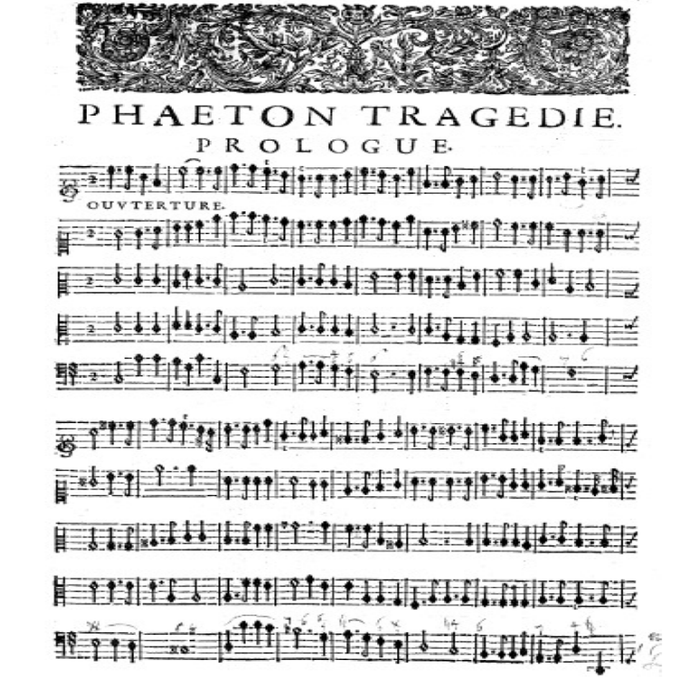
Analyses (cont.)
Excerpt from Jean-Baptiste Lully’s Phaéton.
Dotted quarter notes and accents serve to provide durational and dynamic accents on the first and third quarter-note beats of most measures.
The tempo of the recorded excerpt was 130 BPM at the quarter-note level.

Slide 16
整理

Slide 17

Different listeners were tapping at different metrical levels to the same
musical excerpt
metric level - Pulses in a metric structure including the beat level, division levels, and multiple levels. (DeLone et. al. (Eds.), 1975, chap. 3)
Rhythmic metre - There are four different time signatures in common use:
Simple duple (ex. 4/4)
Simple triple (ex.3/4 )
Compound duple (ex. 6/8)
Compound triple (ex. 9/8)

Slide 18
M.Davies, P. Brossier, "Fast implementations for perceptual tempo extration“
‧ If primary tempo > 120 bpm, and time-sig is duple,
then secondary tempo is primary * 1/2
‧ If primary tempo < 120 bpm, and time-sig is duple,
then secondary tempo is primary * 2
‧ If time-sig is triple,
then secondary tempo is primary* 1/3

